Slide 1
RACI Matrix

Slide 2

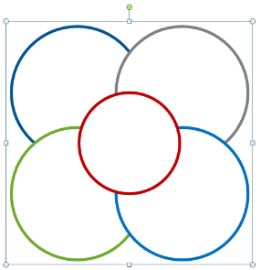
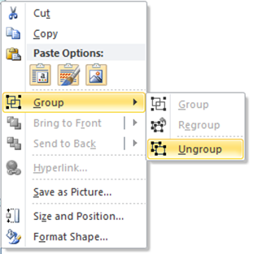
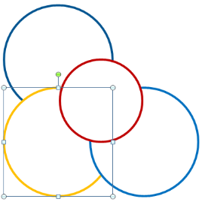
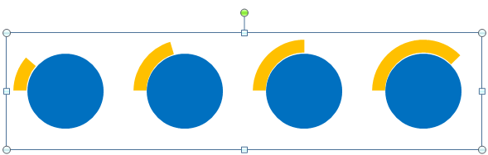

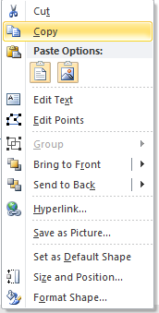


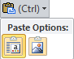

How to Use Our Editable PPT Products
Scale
Your image can be made large or small and will still look fantastic. Just select it and drag from one of the corners. Hold down Shift key to scale proportionally.
Group & Ungroup Objects
Right-click on the object.
Choose “Group”> “Ungroup” in the dialog box.
You can now manipulate the shapes at will to suit your requirements by coloring or removing the shape.
Changing Color
Select any shape click on “Format” on the Ribbon
Then click on “Shape fill” Select any color from Fill that you want
Multiply the Value
Select a diagram Right Click on it > Select Copy
Go to your new slide, Right Click > and from the Paste Options > Select “Use Destination Theme (H)”
By pasting that copied diagram onto new slides you can multiply the product value as much as you want.
Learn more from our 24point0 Tips and Tutorials http://www.24point0.com/ppt-shop/tips-and-tutorials/

Slide 3
RACI Matrix
R
Who is RESPONSIBLE
The person who is assigned to do the work.
A
Who is ACCOUNTABLE
The person who takes the final decision and has ultimate ownership.
C
Who is CONSULTED
The person who must be consulted before a decision/ action is taken.
I
Who is INFORMED
The person who must be informed about the decision/ action taken.

Slide 4
RACI Matrix
FUNCTION | Project Owner | Business SME | Business Analyst | Project Manager | Software Engineer
Project planning | A | C | C | R | I
Project initiation | A | C | C | R | I
Business requirements | I | C | R | I | I
Solution design | I | I | C | I | R
Alpha testing | I | I | C | I | R
Beta testing | C | I | C | A | R
Solution delivery | A | I | C | I | C
RESPONSIBLE
CONSULTED
ACCOUNTABLE
INFORMED

Slide 5
RACI Matrix
R | Project Responsibility | Project Manager | Project Sponsor | Project Analyst | Technical Specialist
A | Project Accountability
C | Project Consultant
I | Project Inform
PROJECT INITIATION PHASES
Define project purpose |  | R | A | C | I
Define the scope |  | R | A | C | I
Define deliverables |  | A | C | R | C
Governance structure |  | R | A | C | I
Implementation approach |  | A | C | R | C
Risks and concerns |  | A | I | R | C
Project Charter |  | R | A | C | I

Slide 6
RACI Matrix
PROJECT INITIATION PHASES | Project Manager | Project Sponsor | Project Analyst | Technical Specialist
Define project purpose | R | A | C | I
Define the scope | R | A | C | I
Define deliverables | A | C | R | C
Governance structure | R | A | C | I
Implementation approach | A | C | R | C
Risks and concerns | A | I | R | C
Project Charter | R | A | C | I
Responsibility
Accountability
Consulted
Informed

Slide 7
RACI Matrix
ROLE |  | PLANNING & DEFINITION |  |  |  |  | EXECUTION |  |  |  |  |  | IMPLEMENTATION & CLOSURE
R | A | Project Management Plan | Resource Plans | Project Schedule | Project Financing | Functional Requirements | Solution Design | Technical Specifications | Test Plans | Unit Testing | Reporting | UAT | Solution Deployment | Training Materials | Training | Transition | Project Closure
C | I
Project sponsors |  | A |  | A | A | I |  |  |  |  |  |  |  |  |  |  | C
Steering committee |  | A |  | A | A | I |  |  |  |  |  |  |  |  |  |  | I
Project lead |  | C | A | C | C | A | A | A | A | I |  |  |  |  |  |  | R
SME |  | R | R | R | R | R | C | C | C | I | I | I | A |  |  |  | A
Developers |  | I | I | I | I | C | C |  | A |  | A |  |  |  | A |  | I
Data Analyst |  | A | A | A |  | A | C |  | I |  |  | I | C | A |  |  | I
Infrastructure |  | C |  | C |  | C | A |  | A |  | R |  | R | R | R | I | A
Partners |  | I | I | C | C | C |  |  | I |  |  | I |  |  | I |  | I

Slide 8
The RACI Triangle
R
Who is RESPONSIBLE
A wonderful serenity has taken possession of my entire soul, like these sweet mornings of spring which I enjoy with my whole heart.
AA
Who is ACCOUNTABLE
I am alone, and feel the charm of existence in this spot, which was created for the bliss of souls like mine.
CCCC
Who is CONSULTED
But I must explain to you how all this mistaken idea of denouncing pleasure and praising pain was born
IIIII
Who is INFORMED
I will give you a complete account of the system, and expound the actual teachings of the great explorer of the truth..

Slide 9
The RACI Triangle
R
Who is RESPONSIBLE
A
Who is ACCOUNTABLE
C
Who is CONSULTED
Who is INFORMED
I

Slide 10
RACI – Who’s Who
RESPONSIBLE
ACCOUNTABLE
CONSULTED
INFORMED

